Slide 1
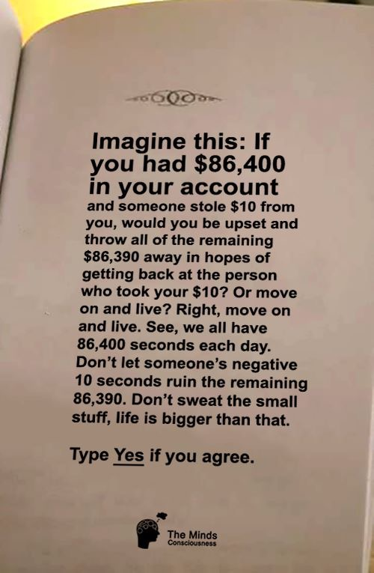

Slide 2
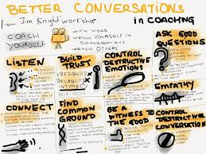

Slide 3
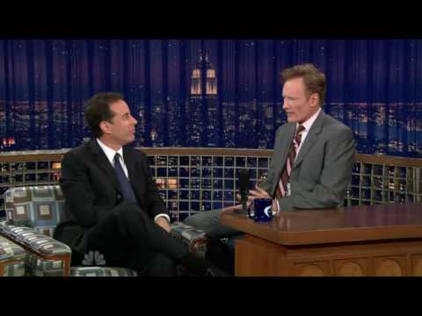

Slide 4
GUIDING QUESTION
Is the way I communicate important?

Slide 5
SUCCESS CRITERIA
· You can provide an opinion on COMMUNICATION.
· You have provided your areas of improvement.

Slide 6
Partner 1
Identify someone whom you want to praise.
Identify 1-2 important conversations you need to have in the future.

Slide 7
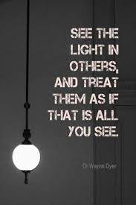
BELIEF #1
I SEE OTHERS AS EQUALS

Slide 8
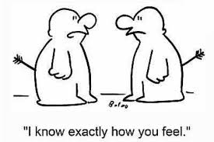
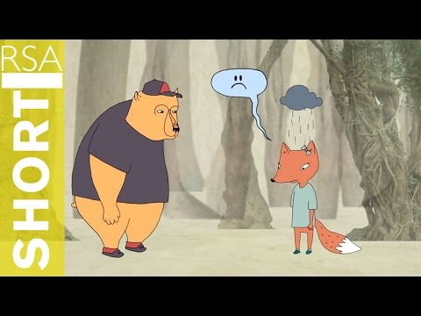
BELIEF #2
I WANT TO HEAR WHAT OTHERS HAVE TO SAY
“There is a big difference between listening and hearing” - G.K CHERTERTON

Slide 9
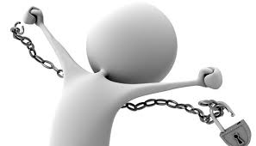
BELIEF #3
“If you insist, they will resist.” - TIMOTHY GALLWEY
I BELIEVE PEOPLE SHOULD HAVE A LOT OF AUTONOMY

Slide 10
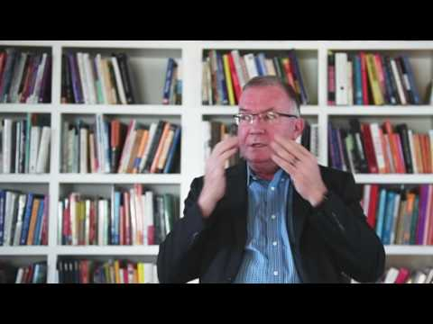
BELIEF # 4
“It’s not our differences that divide us, it’s our judgement about each other” - MARGARET WHEATLEY
I DON’T JUDGE OTHERS

Slide 11
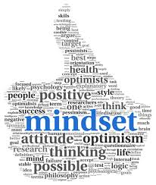
Belief #5
CONVERSATIONS SHOULD BE BACK AND FORTH

Slide 12
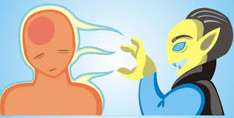
Belief #6
CONVERSATION SHOULD BE LIFE-GIVING
“How would your life be different if… you walked away from gossip and toxic conversations? Let today be the day… speak only the good you know of other people and encourage others to do the same.” - STEVE MARABOLI

Slide 13
WITH A PARTNER
ON A SCALE OF 1-10
ARE YOU ENGAGED IN ALL YOUR CONVERSATIONS? EXPLAIN (10 BEING THAT YOU ARE ENGAGED ALL THE TIME)
MY CONVERSATIONS WITH OTHERS ENERGIZE ME. EXPLAIN (10 BEING THAT THEY ENERGIZE YOU ALL THE TIME)
I USUALLY FEEL BETTER AFTER HAVING A CONVERSATION. EXPLAIN (10 BEING THAT YOU ALWAYS FEEL BETTER)

Slide 14
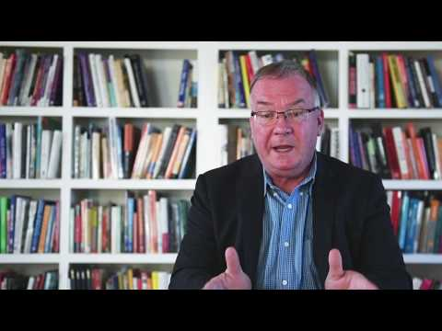

Slide 15
HOW DO YOU FEEL?
WHAT CAN YOU IMPROVE ON?

Slide 16
REFLECTIVE QUESTIONS ON HANDOUT

