Slide 1
An Act of kindness….
Share an act of kindness that either you performed or observed recently… how did it make you feel and why?

Slide 2
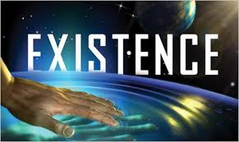
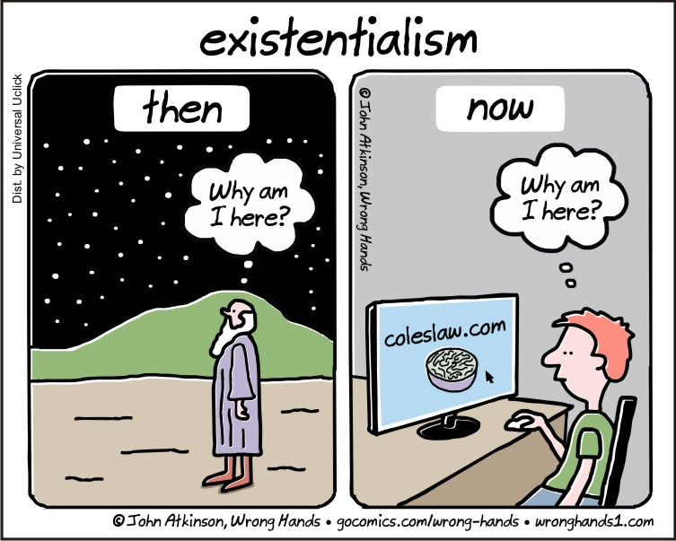

Slide 3
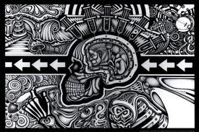
Guiding Question
Do I exist and if so, do I matter?

Slide 4
SUCCESS CRITERIA
I CAN DEFINE WHAT IT MEANS TO EXIST
I HAVE DEFINED MY IDENTITY

Slide 5
Who are YOU?
On a blank sheet of paper answer the following questions:
What do you know about yourself?
What do you want to know about yourself?
Who controls you?
– Do you control yourself?or do outside forces control you?

Slide 6
How do you know you exist??

Slide 7
How do you know you exist??

Slide 8
Existentialism
Existentialists believe that we're born without purpose into a world that makes no sense — but each person has the ability to create his or her own sense of meaning and peace. Discover who invented this relatively new school of philosophy as well as what concepts define existentialism. Existentialism is a term applied to some late 19th- and 20th-century philosophers who may not have agreed about much, but who all believed that each person must define themselves in an absurd, illogical world. The following are the core figures of existentialist philosophy.

Slide 10
It is now time for you to put your view into action!
There is man in the room who may, or may not exist.....

Slide 11
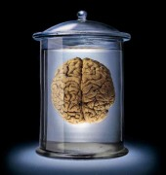
THE TRUTH IS.......
This is Phil, his brain is being kept alive by electromagnetic currents
He thinks he has a life, a family, children etc
Does Phil exist?
?

Slide 12
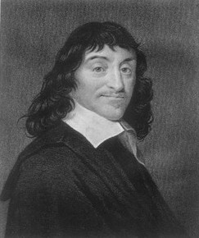
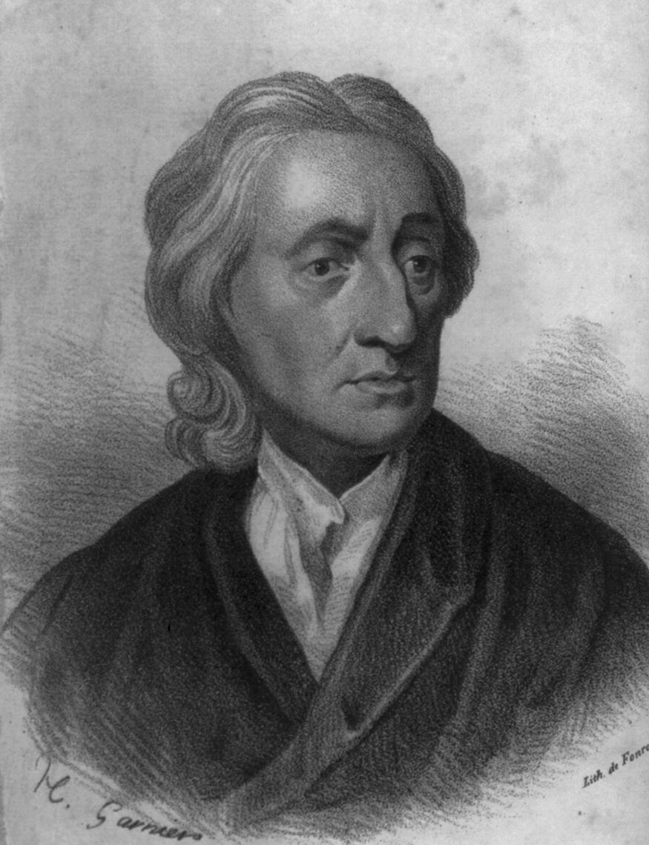
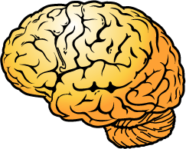
Descartes Vs Locke
‘I think therefore I am’
“A sound mind only exists in a sound body”

Slide 13
Circle time
You will discuss the questions provided… do so with a partner.

Slide 14
Class Discussion
When it is your turn you must read your question and then give your opinion first.

Slide 15
ETHICAL REFLECTION # 1
Does your existence matter?
Step 1 - My opinion is...
Step 2 - I think this because...
Step 3 - Another reason...
Step 4 - Other people might think differently. They might think that…
Step 5 - Another reason they might give is…

