Slide 1
SEXUAL ORIENTATION GENDER IDENTITY AND BUILDING CONNECTION
Ethics 2017

Slide 2
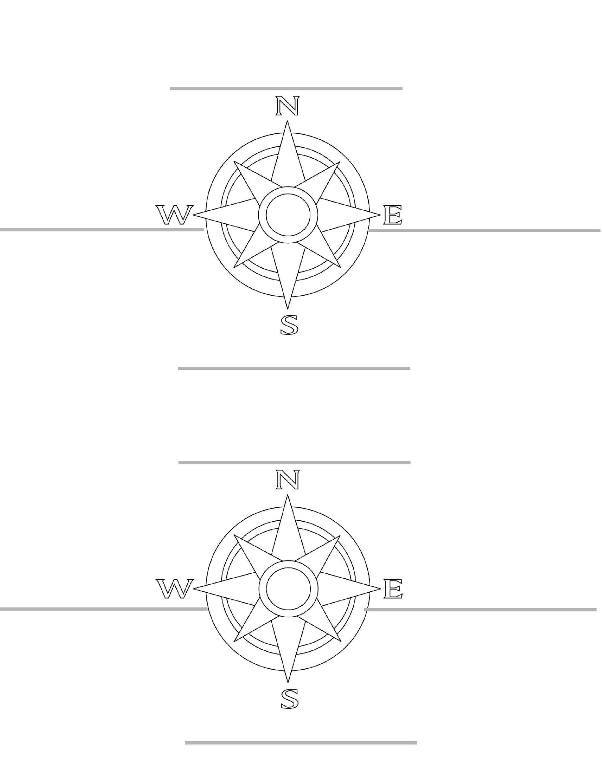
PARTNER PREPARATION

Slide 3
FRIENDLY REMINDERS:
Be RESPECTFUL and MINDFUL of others and their feelings
Raise your hand to speak
Enter class with an open mind
There is a time to listen and a time to ask questions
Maturity level required

Slide 4
GUIDING QUESTION
Success Criteria:
I understand the impact social slang has on others.
I understand how to emotionally connect with others through empathy.
I have created and answered a related ethical reflection question.
HOW CAN WE BUILD CONNECTION WITH SOMEONE STRUGGLING WITH “COMING OUT”?

Slide 5
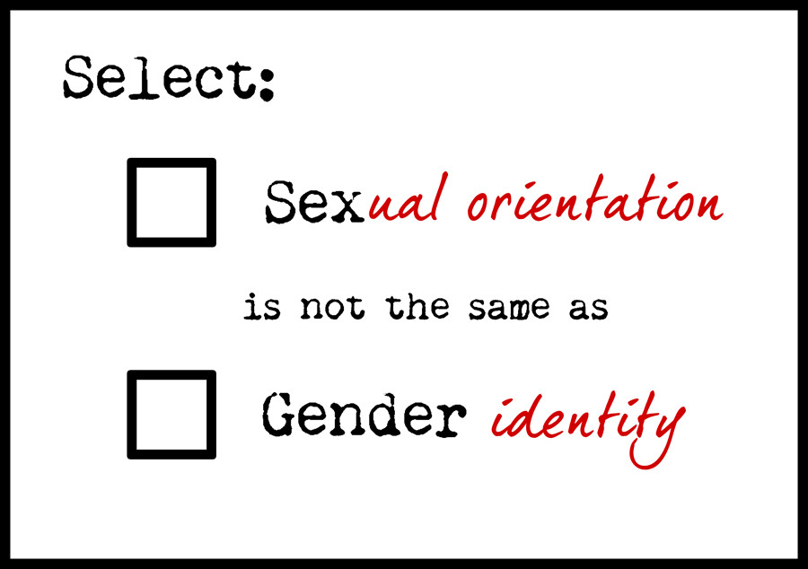
SEX VS. GENDER … WHAT IS THE DIFFERENCE?
SEX
Sex refers to biological differences; chromosomes, hormonal profiles, internal and external sex organs.
GENDER
Gender describes the characteristics that a society or culture delineates as masculine or feminine.

Slide 6
IDENTITY VS. ORIENTATION
Gender Identity (what is in your head)
How you, in your head, think about yourself… your internal and individual experience of gender. The sense of being a woman, a man, both, neither, or anywhere along the gender spectrum. May be the same as or different from their birth-assigned sex.
Sexual Orientation (what is in your heart)
Who you are physically, spiritually and emotionally attracted to.
Biological Sex (what is in your pants)
Your internal and external sex organs, hormones and chromosomes.
Gender Expression (How and what you show the world)
How you express yourself and your gender, through the way you act, dress, behave and interact.

Slide 8
PSA – A message to the public with the objective of raising awareness and changing public attitudes and behavior towards a social issue.

Slide 9
DISCUSSION QUESTIONS – WARM UP
NORTH PARTNER
Are the terms “no homo” and “That’s so Gay” used as a derogatory term or a put down? Why?

Slide 10
“DEFINE ME”
South Partner
REFLECTION QUESTIONS:
What was the message being portrayed in the video?
What was powerful about the way the video started and ended?
What is your reaction/overall opinion of the video?

Slide 11
COMING OUT OF THE CLOSET
WEST PARTNER

Slide 12
COMING OUT OF THE CLOSET
DISCUSSION QUESTIONS:
Who has closets? Why/How?
“There is no harder… there is just hard.”
How relevant is this quote?
Is this an important mindset to have?
How can comparisons do more harm than good?

Slide 13
COMING OUT OF THE CLOSET
DISCUSSION QUESTIONS:
EAST PARTNER
What are you taking away from this video?
What is your overall reaction/opinion?
How can you relate to Ash Beckham’s “Coming Out of the Closet” speech?

Slide 14
Ethical Reflection #1
Create a reflection question in connection to today’s subject.
Respond using the ethical prompts.
MAKE SURE TO SELF ASSESS
SUGGESTED QUESTION:
DO YOU AGREE WITH THE STATEMENT, “ THERE IS NO HARDER, JUST HARD” WHEN LOOKING AT WHAT PEOPLE STRUGGLE WITH?

Slide 15
SEX VS. GENDER … WHAT IS THE DIFFERENCE?

Slide 16
VIDEOS – PUBLIC SERVICE ANNOUNCEMENT
DISCUSSION
How did the boys use the term “That’s so Gay”?
When Wanda first asked them to stop saying it, did they look like they were going to listen to her? Why?
What did she do to help them understand where she is coming from?
How did the woman in video #2 make her point? How was this an unique approach?
Could you do this if you heard someone being outwardly rude? Is it effective?
PSA – A message to the public with the objective of raising awareness and changing public attitudes and behavior towards a social issue.

