Slide 1
How can you ensure your existence “matters”?

Slide 3
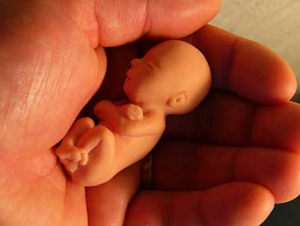
Meaning of life

Slide 4
Guiding Question
What brings meaning or purpose to your life?

Slide 5
Success Criteria
You have described what it means to have purpose
You have shared your fears
You have provided your personal perspective on the meaning of life

Slide 6
WHAT ARE YOUR FEARS?

Slide 7
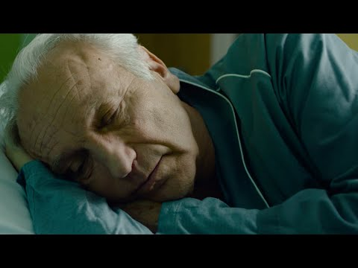
Will you live your life?

Slide 8
What will you do to own your life?
Do you think you will be courageous enough to live your life?

Slide 9
We all have goals that give our lives meaning and purpose…

Slide 10
My Goals in life
On your sheet
What are your life aims
- In 1 year
In 10 years
At the end of your life

Slide 11
WHAT DOES A LIFE OF PURPOSE LOOK LIKE TO YOU?

Slide 12
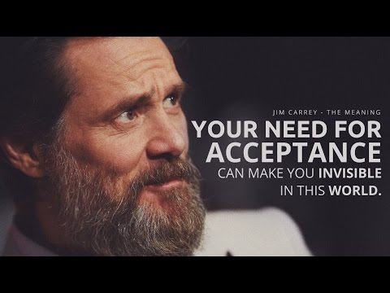
Post it note: What is the purpose of life?

Slide 13
ETHICAL REFLECTION #2
Do you believe it is important to have meaning or purpose in life?

