Slide 1
THE FUTURE OF HUMANITY

Slide 2
Guiding Question
Is there hope for humanity?

Slide 3
Success Criteria
Provide reasons for and against
Provide your personal stance

Slide 4
ANIMAL CRUELTY
“Wild animals never kill for sport. Man is the only one to whom the torture and death of his fellow-creatures is amusing in itself.”

Slide 5
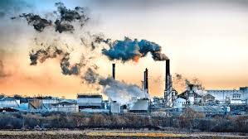
POLLUTION
“Sooner or later, we will have to recognise that the Earth has rights, too, to live without pollution. What mankind must know is that human beings cannot live without Mother Earth, but the planet can live without humans”. - Evo Morales

Slide 6
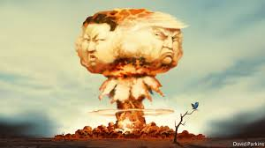
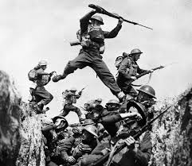
WAR THEN

Slide 7
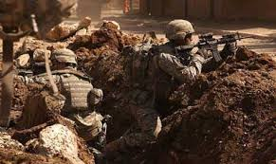
WAR NOW

Slide 8
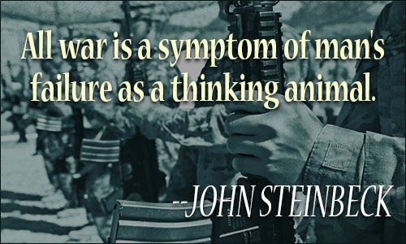
We will not learn how to live together in peace by killing each other's children. I do not know with what weapons World War III will be fought, but I do know that World War IV will be fought with rocks. There never was a good war, or a bad peace. When the rich wage war, it is the poor who die.

Slide 9
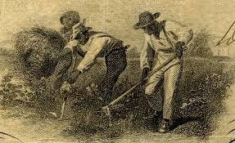
Slave labour then

Slide 10
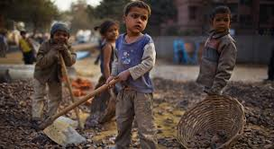
Slave labour today

Slide 11
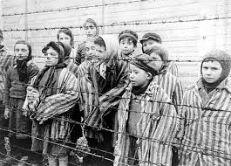
The disregard for human life

Slide 12
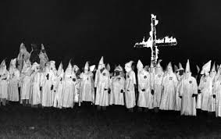
Racism then

Slide 13
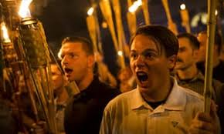
Racism now

Slide 14
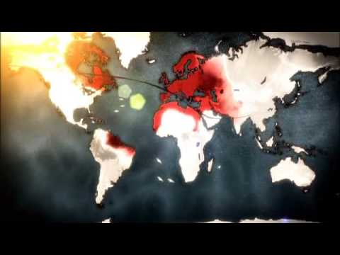

Slide 15
DO YOU THINK WE CAN EVER PROTECT EVERYONE’S HUMAN RIGHTS?

Slide 16
EVALUATING PROGRESS
ARE WE ANY BETTER THAN PAST GENERATIONS?

Slide 17
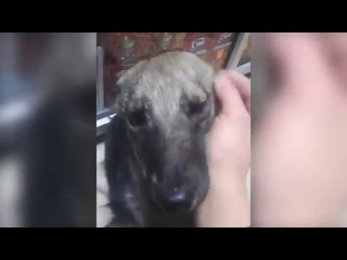
The good in humanity

Slide 18
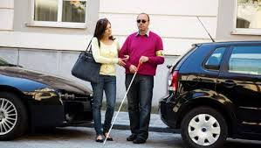
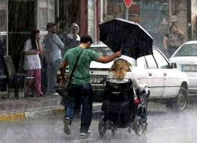
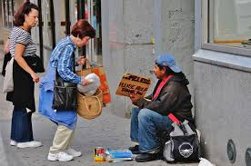
The good in humanity

Slide 19
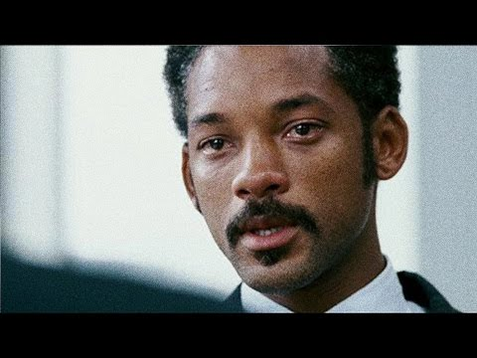
The good in humanity

Slide 20
REFLECTION QUESTION
Do you believe the human species deserves to survive?

